Slide 1
SUBNETTING

Slide 2
IPV4
  In IPv4, an address is a 32 bit quantity that uniquely identifies a network interface.
  In IPv4 there are (2)³² = 4,294,967,296 unique addresses possible
  IP addressing was designed to allow hosts on one network to communicate with a host on a different network regardless of the type of LANs the hosts are participating in.

Slide 3
  BIT: A bit is one digit, either a 1 or a 0.
  BYTE: A byte is 7 or 8 bits, depending on whether parity is used. For the rest of this chapter, always assume a byte is 8 bits.
  OCTET: An octet, made up of 8 bits, is just an ordinary 8-bit binary number. In this chapter, the terms byte and octet are completely interchangeable.
  Network address: This is the designation used in routing to send packets to a remote network—for example, 10.0.0.0, 172.16.0.0, and 192.168.10.0.
  Broadcast address: The address used by applications and hosts to send information to all nodes on a network is called the broadcast address.
  CIDR – (classless inter domain routing) total number of network bits

Slide 4
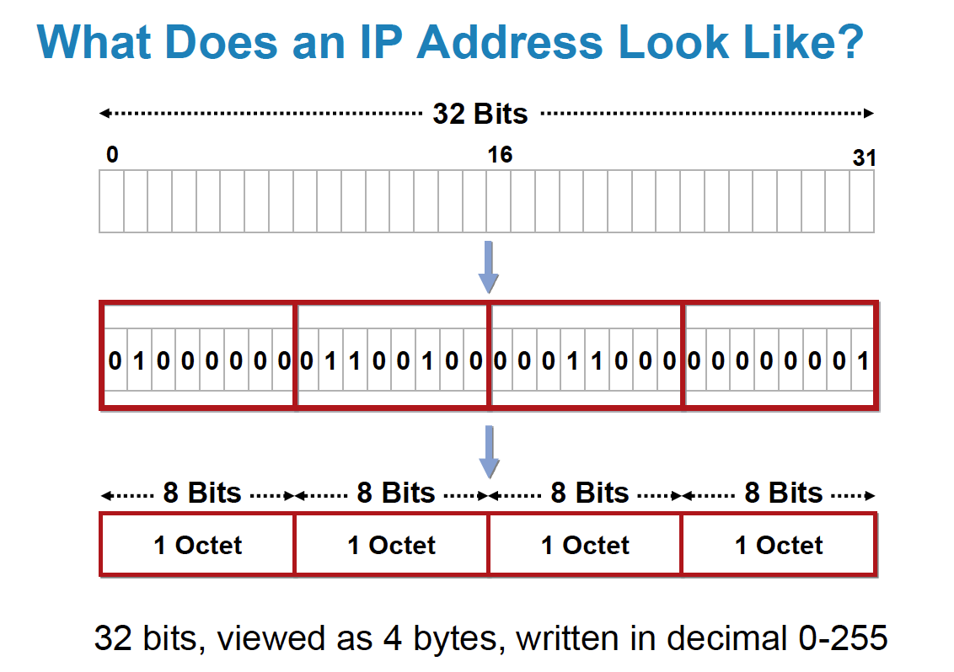
IP Addressing
How does IP address look like ?

Slide 5
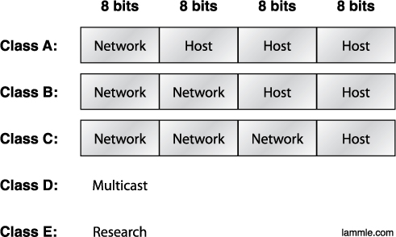
IP Addressing
Subdividing an IP address into a network and node address is determined by the class designation of one’s network. This figure summarizes the three classes of networks

Slide 6
IP class range
Class | 1st Octet Decimal Range | Default Subnet mask
A | 1 – 126 | 255.0.0.0
B | 128 - 191 | 255.255.0.0
C | 192 - 223 | 255.255.255.0
D | 224 - 239 | Reserved for multicasting
E | 240 - 254 | Experimental, used for research

Slide 7
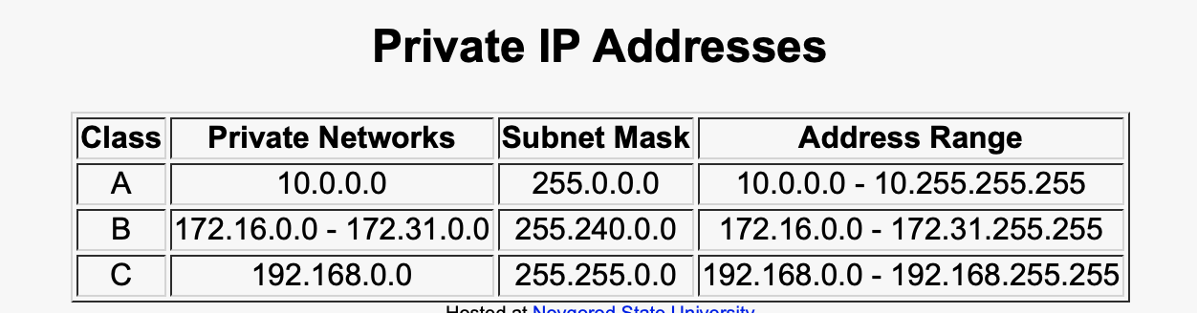
IP Addressing

Slide 8
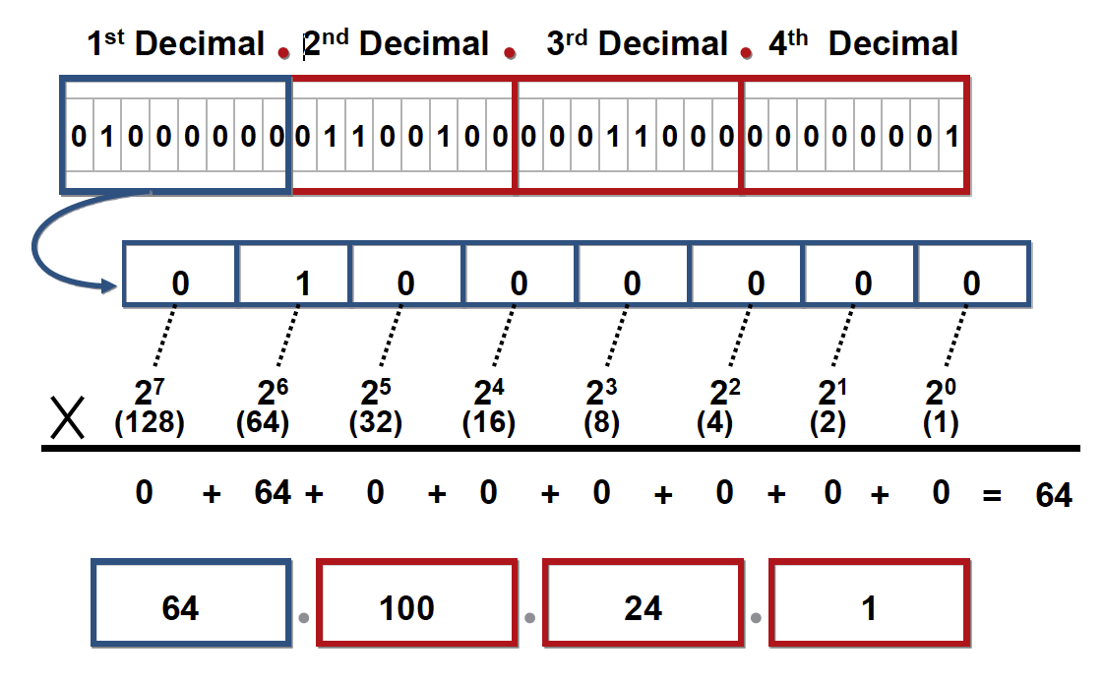
IP Addressing
IP Address Format in Dotted Decimal

Slide 9
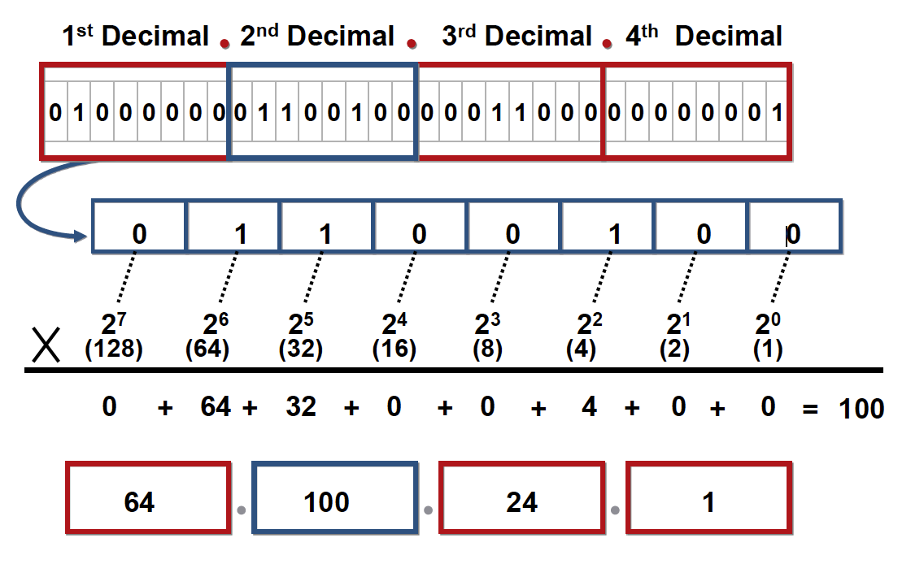
IP Addressing
IP Address Format in Dotted Decimal

Slide 10
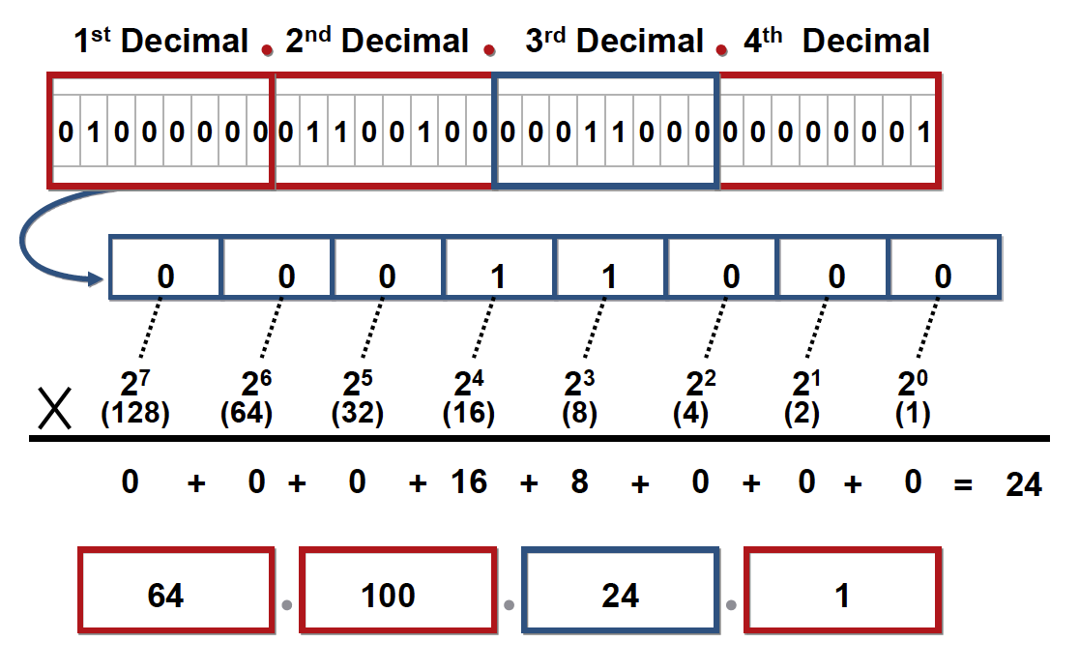
IP Addressing
IP Address Format in Dotted Decimal

Slide 11
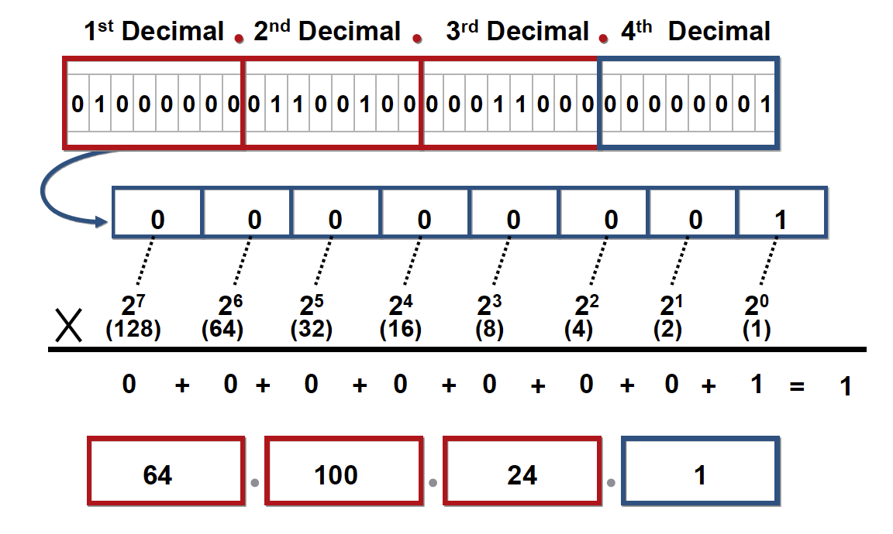
IP Addressing
IP Address Format in Dotted Decimal

Slide 12
4 Questions….
Process of diving a large network into multiple small networks.
What is the Subnet mask?
What is the number of network?
What is the number of hosts?
How many valid host are there?

Slide 13
subnetting
network | 1 | 2 | 4 | 8 | 16 | 32 | 64 | 128 | 256
hosts | 256 | 128 | 64 | 32 | 16 | 8 | 4 | 2 | 1
CIDR | /24 | /25 | /26 | /27 | /28 | /29 | /30 | /31 | /32
Subnet mask | 255.255.255.0 | 255.255.255.128 | 255.255.255. 192 | 255.255.255. 224 | 255.255.255. 240 | 255.255.255. 248 | 255.255.255. 252 | 255.255.255. 254 | 255.255.255. 255

